Slide 1
AMAZON PRODUCT REVIEW ANALYSIS ON TOOLS & HOME IMPROVEMENT PATIO LAWN & GARDEN CATEGORIES (1998-2018)
By:
Animesh Gour
Naveen Singh
Adriraj Das

Slide 2
INTRODUCTION
Amazon was launched by Jeff Bezos in the year 1994.
In 1995, The first product launched by Amazon was a book in 50 states and in 45 countries within 30 days.
Within 26 years, Amazon became the world's largest online retailer and a household name. The Amazon name has become synonymous with online shopping and continues to grow by developing new products, acquisitions, and numerous service offerings to enlarge the customer base.
Nowadays, almost 150.6 million people turn to the Amazon app for their shopping needs.
1

Slide 3
PROBLEM STATEMENT
The goal of this project is to monitor an enormous number of reviews. By monitoring the entire review history, we will analyse the tone, language, keywords, and trends over time.
Identification of current trends in data to classify products which are popular among customers.
Text processing of user reviews and clustering based on product prices and ratings, to identify trends in data which will help in inventory management.
Time Series Analysis to predict future trends with respect to product sales and product demand based on past data.
To provide valuable insights which will in turn increase the success rate of existing and new products and help Amazon make smarter business decisions.
2

Slide 4
DATA DICTIONARY
Pg No. 5
Metadata:
Title: Name of the product.
Brand: Brand the product belongs to.
Main_cat: Main Category the Product belongs to.
Price: Price of Product
Asin (Amazon Standard Identification Number): Product ID
5-Core data:
Overall: Rating of the product
Verified: If account is verified or not
Reviewer ID: ID of the reviewer
Asin: Product ID
Review Text: Textual content of the review
Ratings data:
Rating: The rating provided by the customer
Reviewer ID: ID of the reviewer
Date_Time: Date and time of the review given
Asin: Product ID
3

Slide 5
DATA WRANGLING
Data Collection
Data Restructuring
Data Cleaning
Data Enriching
Data Exportation
DATA WRANGLING
4

Slide 6
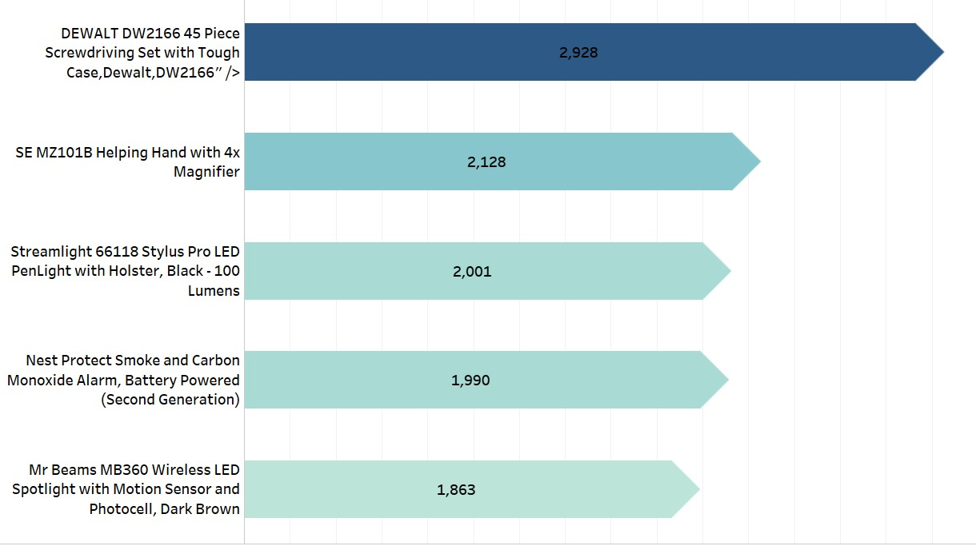
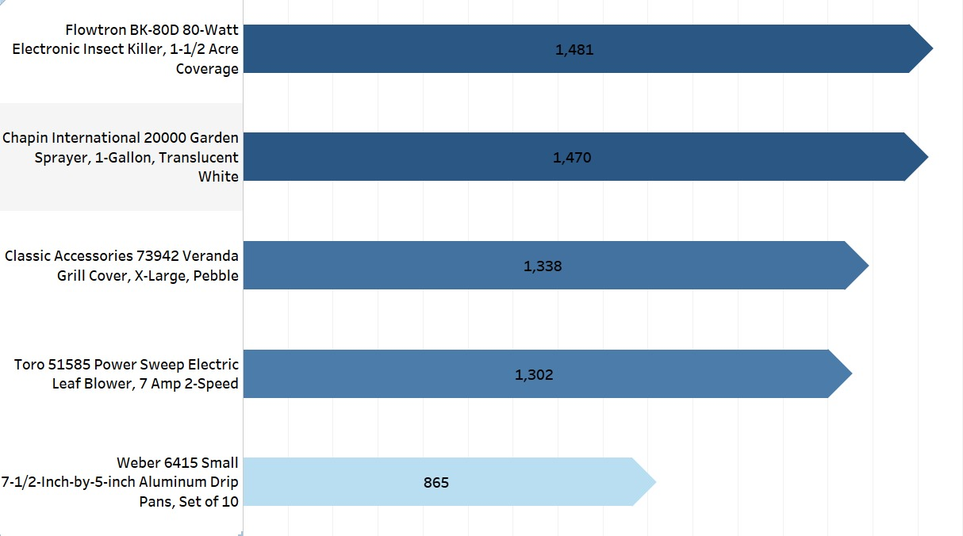
EDA For Popular Products
Tools & Home Improvement
Patio Lawn & Garden
5

Slide 7
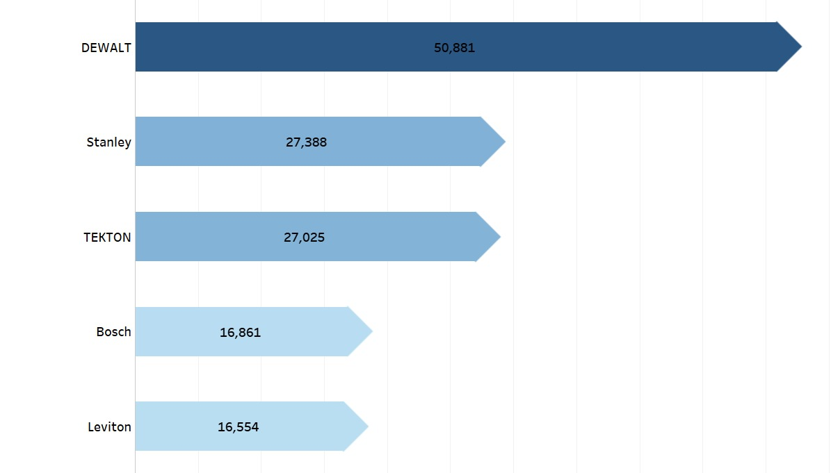
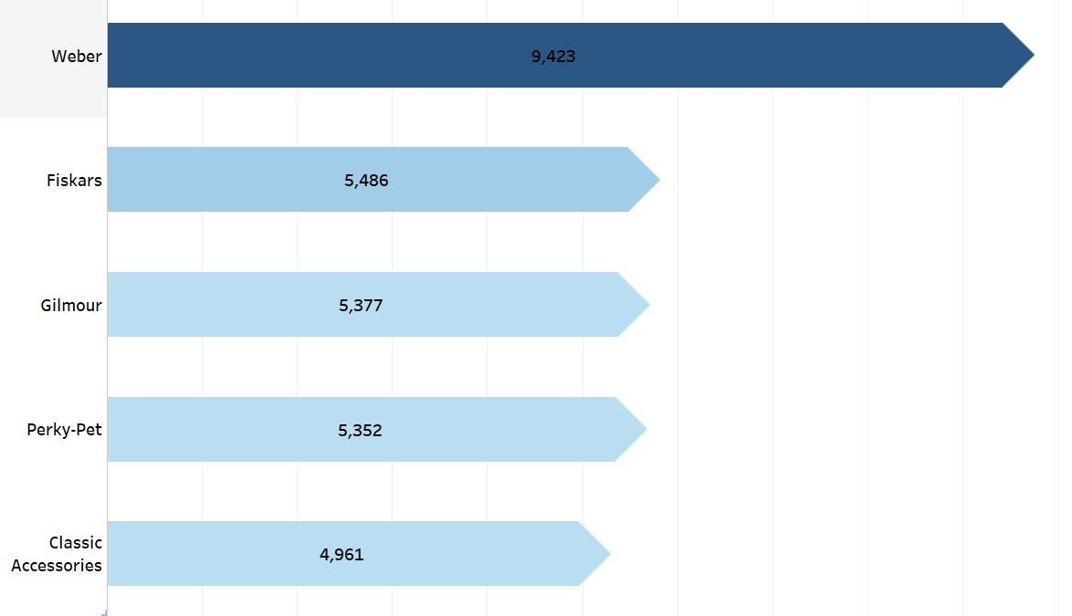
TOP 5 Most Popular Brands
P No. 8
Tools & Home Improvement
Patio Lawn & Garden
6

Slide 8
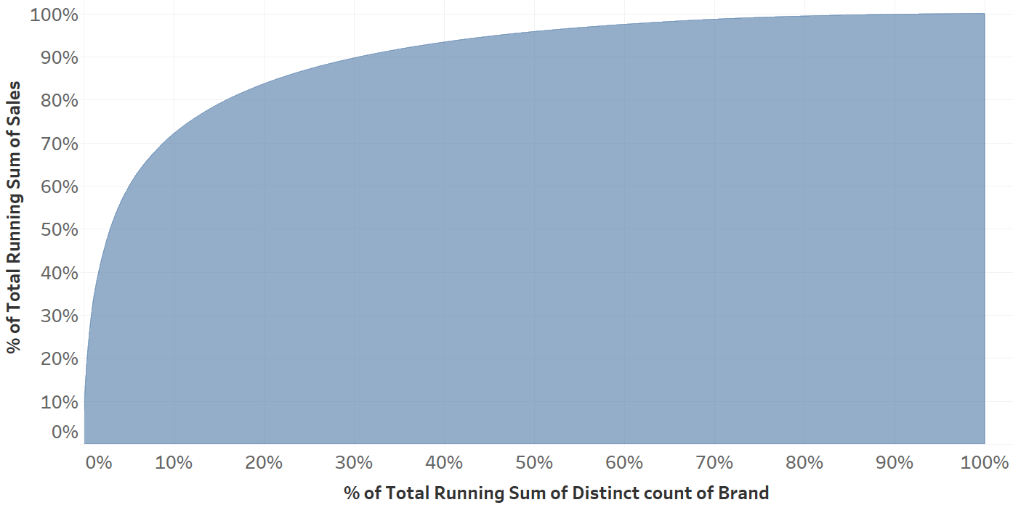
Pareto Chart Representing Percentage Sales Distribution Among brands
7

Slide 9
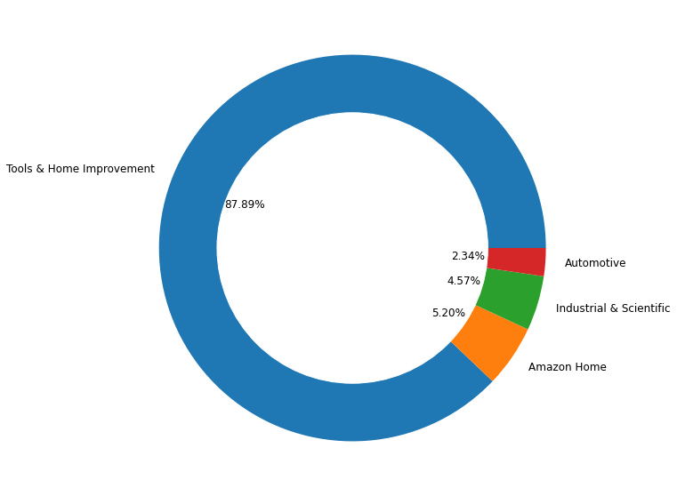
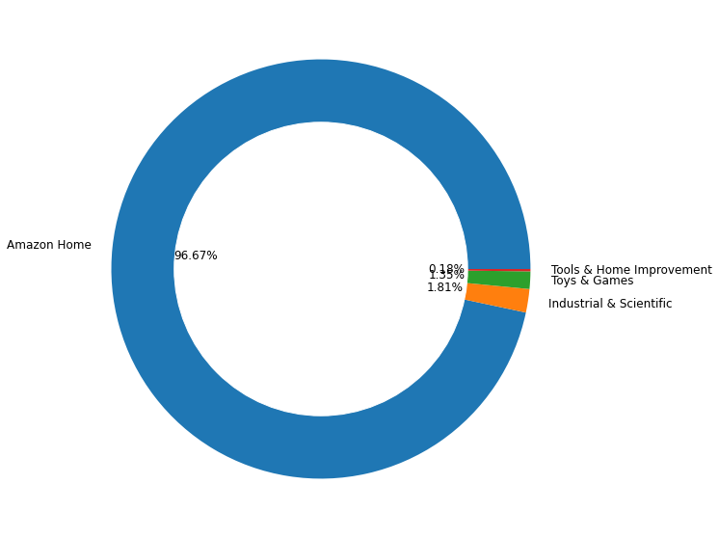
Distribution of sub-categories in Tools & Home Improvement and Patio Lawn & Garden categories
Tools & Home Improvement
Patio Lawn and Garden
8

Slide 10
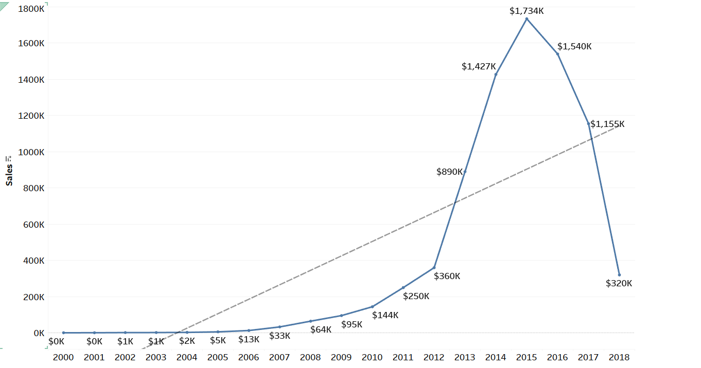
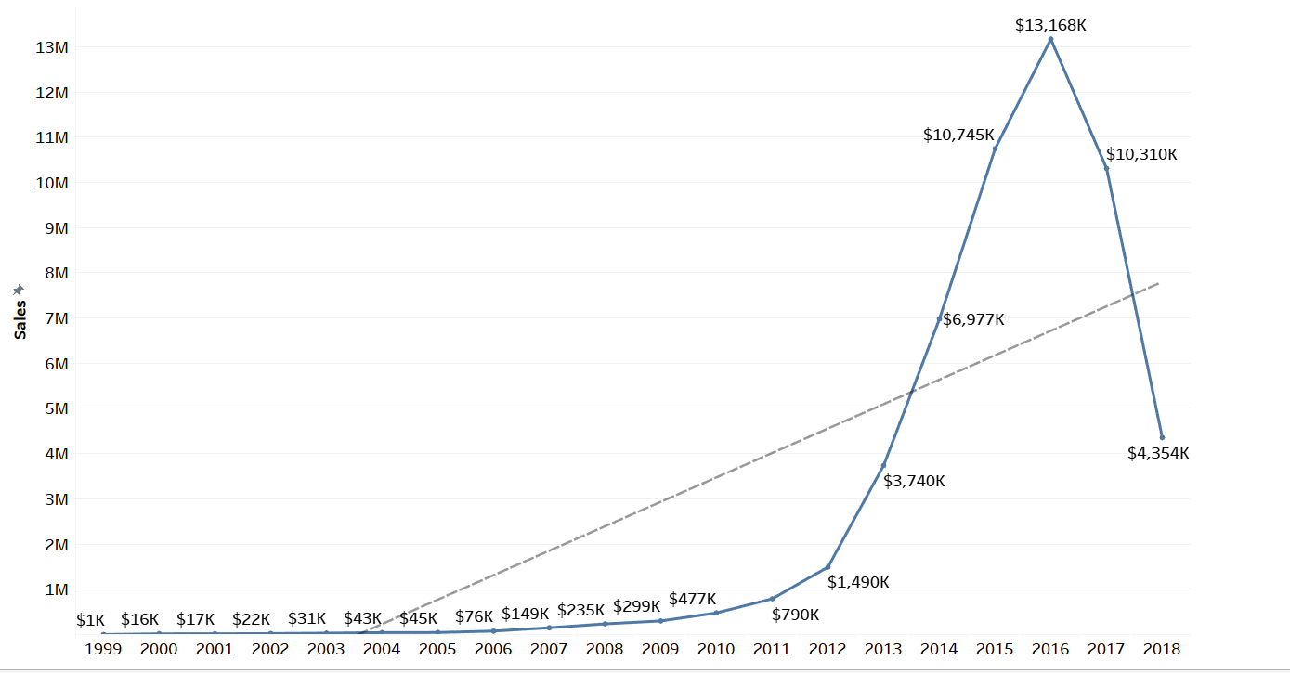
EDA for total sales
Patio Lawn & Garden
Tools & Home Improvement
9

Slide 11
List of business questions Solved by EDA
.
Analysis on Style Column: a) Top 10 colors in demand b) Top 10 Formats in demand c) Top 10 Styles preferred by customers d) Top 10 sizes in demand e) Top 10 wattage preferences.
Count distribution of rating.
Count distribution of verified vs non-verified customers.
Percentage distribution of verified customers across different ratings.
Count distribution of verified and not verified customers across ratings.
Top 10 most popular products
Top 20 most popular brands
Top 5 most reviewed sub-categories
Top 20 Customers based on the number of orders placed
Price distribution across sub-categories
Price distribution across the top 20 brands
Distribution of sales with time among reviewed products (daily, monthly, quarterly, sales).
Tableau dashboard link: https://public.tableau.com/app/profile/animesh.gour/viz/TOOLS_PROJECT_DSBRD/Dashboard1?publish=yes
https://public.tableau.com/app/profile/animesh.gour/viz/patioprojectdashboard/Dashboard1?publish=yes
10

Slide 12
Sentiment ANALYSIS ON PRODUCT REVIEWS
Text Pre-processing:
Upper case to lower case.
Removal of numbers and special characters.
Removal of extra spaces.
Removal of stop words.
Lemmatization.
Text Extraction/Vectorization:
TFIDF Vectorization
Ngram vectorization.
Modelling:
Multinominal Naïve Bayes
Logistic Regression
Fasttext
Test for Model Accuracy
Choose model giving best accuracy score.
Bag of words vectorization.
11

Slide 13
MODEL COMPARISON
MODEL NAME | PRECISION | RECALL | F1-SCORE
One vs Rest (TFIDF) | 85% | 88% | 85%
One vs Rest (Bag of Words) | 84% | 87% | 84%
One vs Rest (Bigram) | 84% | 87% | 84%
Naïve Bayes (TFIDF) | 82% | 86% | 79%
Naïve Bayes (Bag of Words) | 83% | 86% | 84%
Naïve Bayes (Bigram) | 85% | 87% | 82%
Fasttext | 88% | 87% | 88%
12

Slide 14
CHECKING MODEL PERFORMANCE ON SAMPLE REVIEWS
Pg. 14
We observe that our model performs with great accuracy.
It is a robust model and can be used to analyse the sentiment of future user reviews.
The main advantage of using fasttext modelling is that it performs word embeddings via Word2Vec vectorization which is very useful for analysing rarely occurring words.
TEXT | PREDICTION | ACTUAL
great value for money | positive | positive
would recommend this product | positive | positive
bad product wont recommend | negative | negative
poor design quality | negative | negative
unsure about its durability | neutral | neutral
average build | neutral | neutral
13

Slide 15
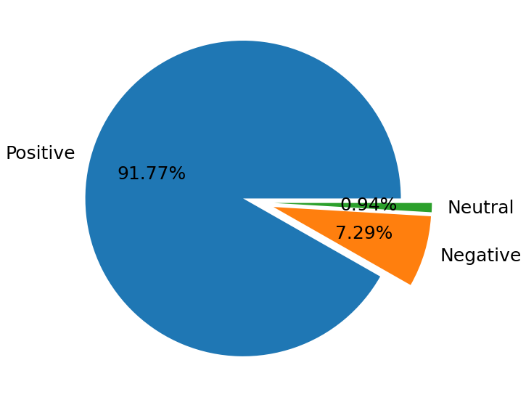
FAST-TEXT MODEL INFERENCES
It is observed that more than 90% of the reviews were positive.
Less than 8% of reviews were negative.
Only 1% of the reviews were neutral.
14

Slide 16
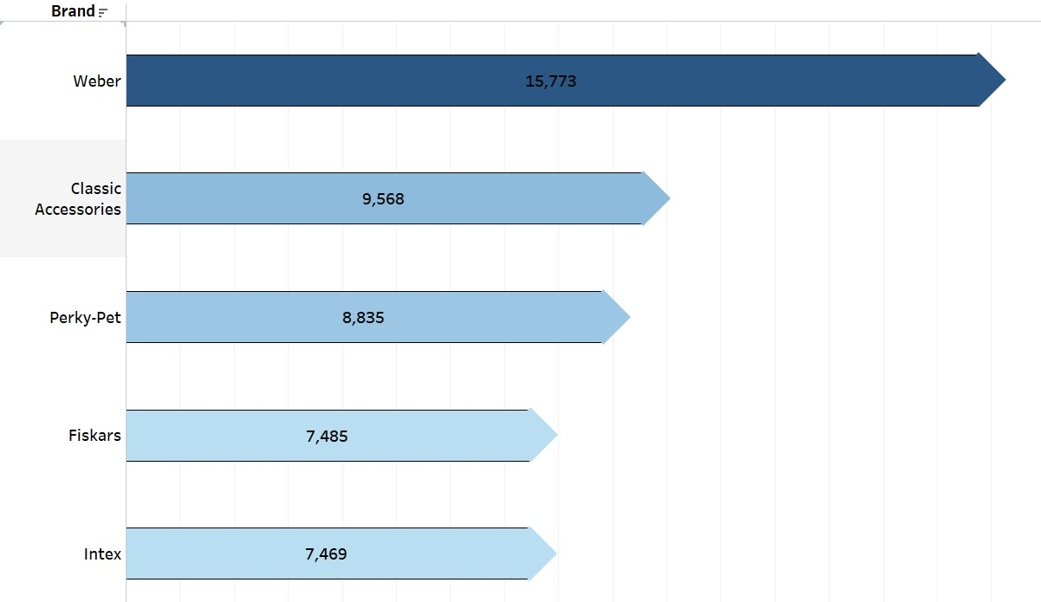
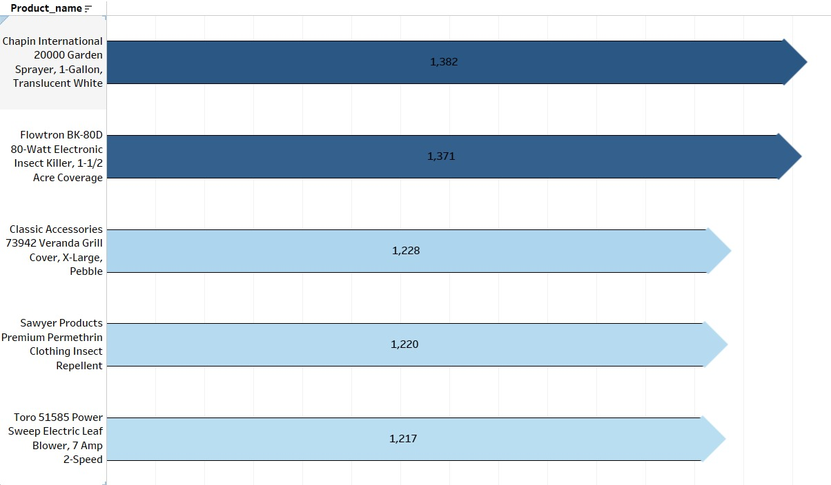
POSITIVE REVIEWS ANALYSIS
List of Top 5 Most Popular Brands
List of Top 5 Most Popular Products
15

Slide 17
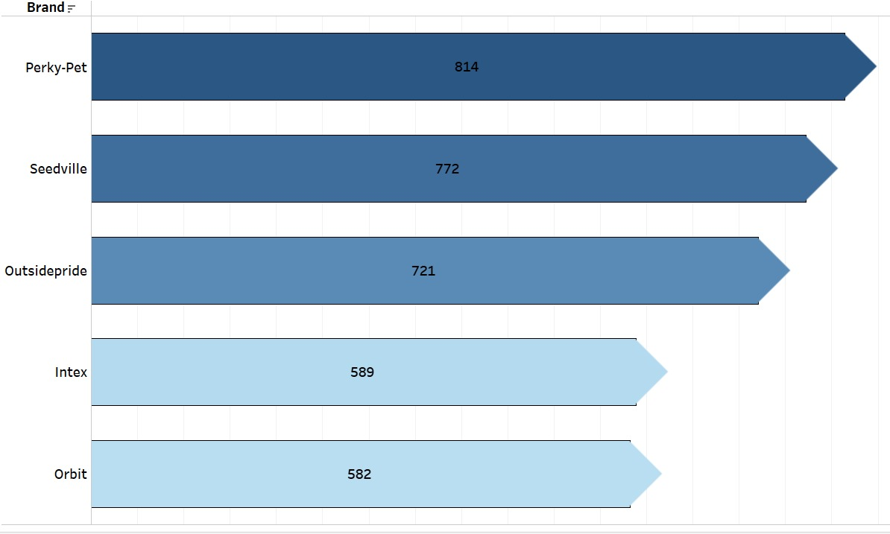
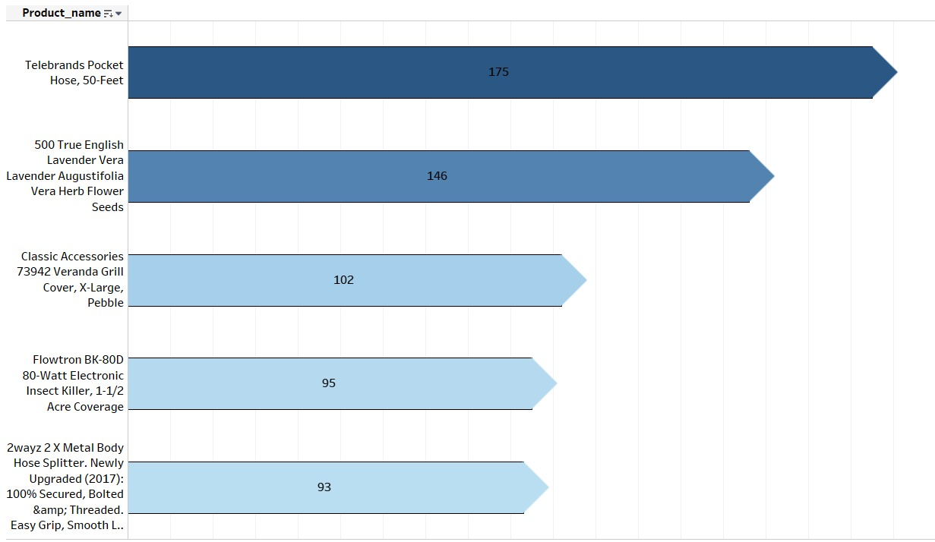
NEGATIVE REVIEW ANALYSIS
List of Top 5 Most Sought After Brands
List of Top 5 Most Sought After Products
16

Slide 18
Sales Comparison (in thousands))
17

Slide 19
CLUSTERING OF PRODUCTS BASED ON PRODUCT PRICE & RATING
Data Collection.
Feature Selection.
Ideal number of cluster selection using elbow method and silhouette scores.
Observe and analyse trends among the clusters formed.
18

Slide 20
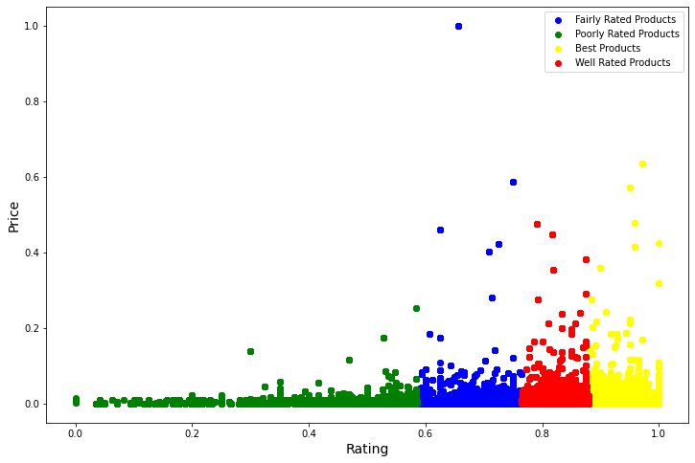

CLUSTERING PRODUCTS BASED ON THEIR Price & Rating
CLUSTER | Avg Price
Best Rated | 29.59
Well Rated | 33.01
Fairly Rated | 32.33
Poorly Rated | 32.70
CLUSTER | NO. OF PRODUCTS
Best Rated | 283377
Well Rated | 293487
Fairly Rated | 119897
Poorly Rated | 30719
19

Slide 21
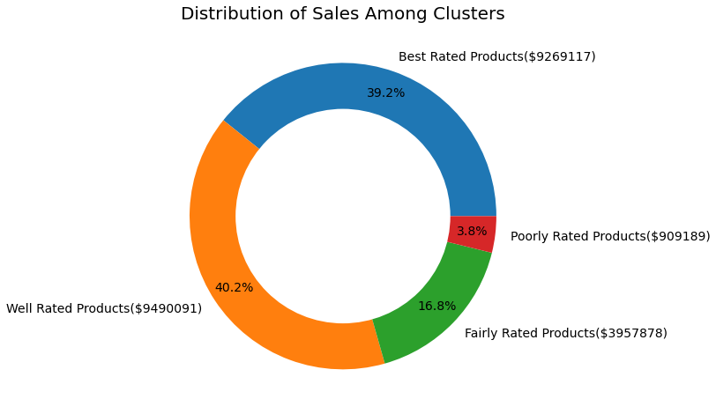
SALES AMONG CLUSTERS
20

Slide 22
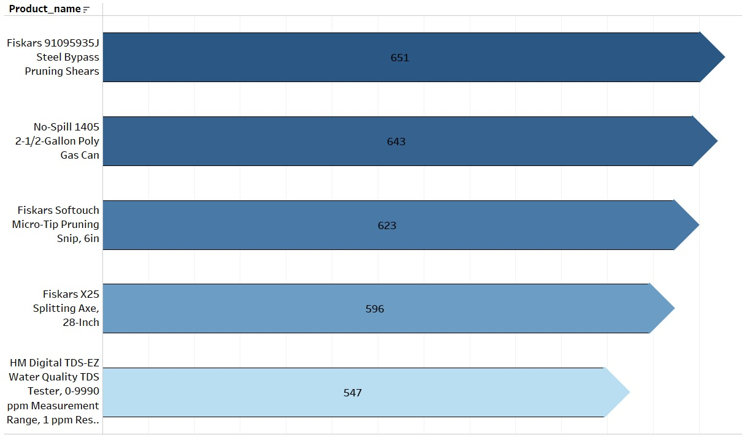
ANALYSIS ON The BEST Rated PRODUCTs
21

Slide 23
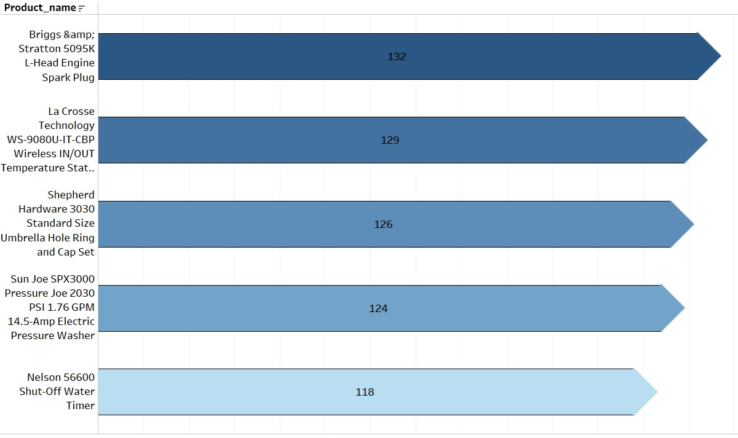
ANALYSIS OF POORLY RATED PRODUCTS
22

Slide 24
SALES ANALYSIS FOR THE CLUSTERS WITH RESPECT TO Popular BRANDS
Best Rated Products Cluster
Poorly Rated Products Cluster
BRAND | SALES (THOUSANDS)
Weber | 319
Intex | 238
Hayward | 165
Fiskars | 121
Classic Accessories | 106
BRAND | SALES (THOUSANDS)
Intex | 38
Scotts | 20
Lifetime | 16
Weber | 14
Hydrofarm | 11
To check the products belonging to:
Best Rated Products Cluster: Click Here
Well Rated Products Cluster: Click Here
Fairly Rated Products Cluster: Click Here
Poorly Rated Products Cluster: Click Here
23

Slide 25
TIME SERIES FORECASTING
Data Collection
Data Preparation
Date as DateTime dtype, Sorting in increasing order of date, Set date as index, Date_range method, Resampling
Stationarity Testing
Rolling mean & std, Augmented Dickey-Fuller Test, Making data stationary by differencing
Finding the best value of lags (p, q, d)
ACF and PACF chart, Auto ARIMA
Build Model
Train test split By using fit method
Forecasting By using predict method
Model Evaluation
Comparing models and calculating error
24

Slide 26
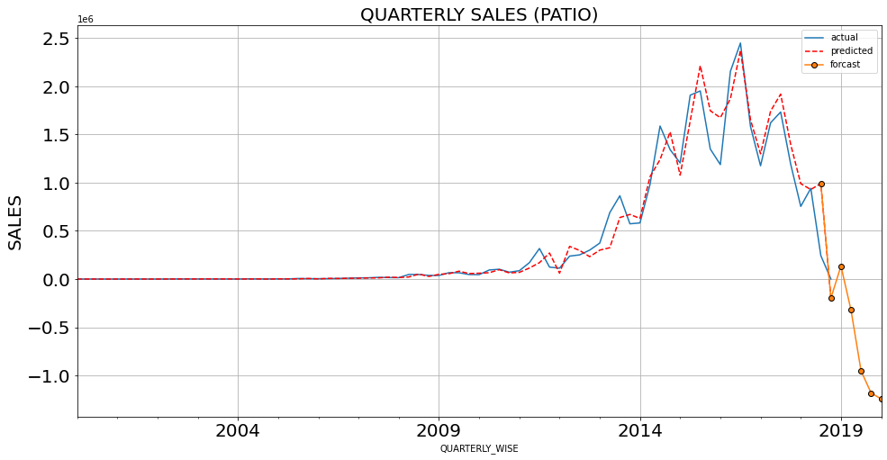
ActuAL,PREDICTED AND FORECASTED SALES OF PATIO LAWN AND GARDEN
25

Slide 27
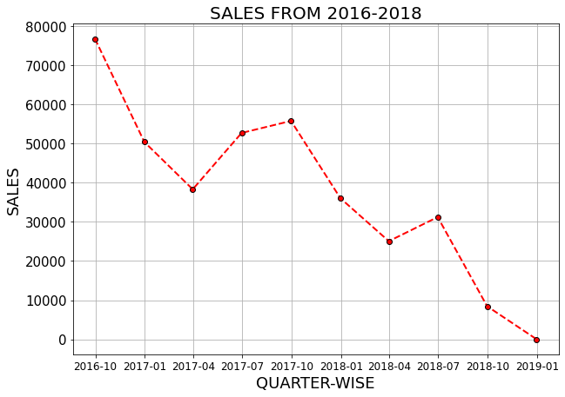
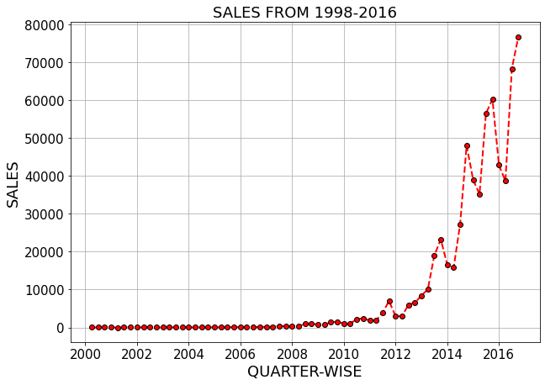
26

Slide 28
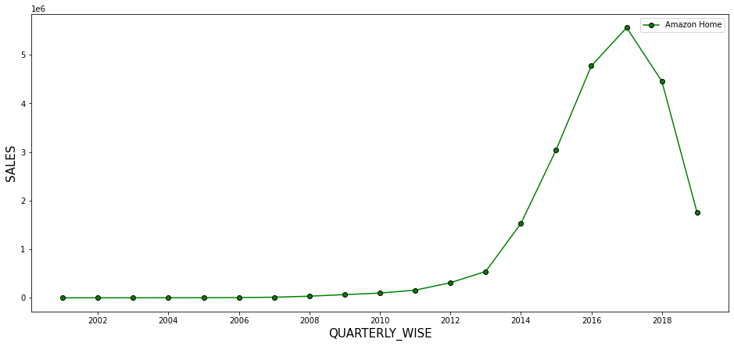
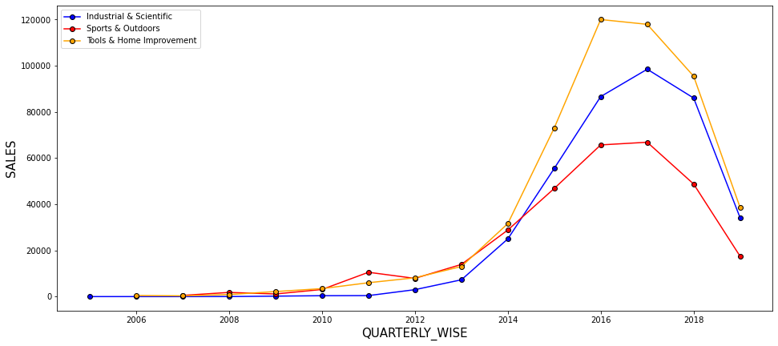
Quarterly sales of the main category
27

Slide 29
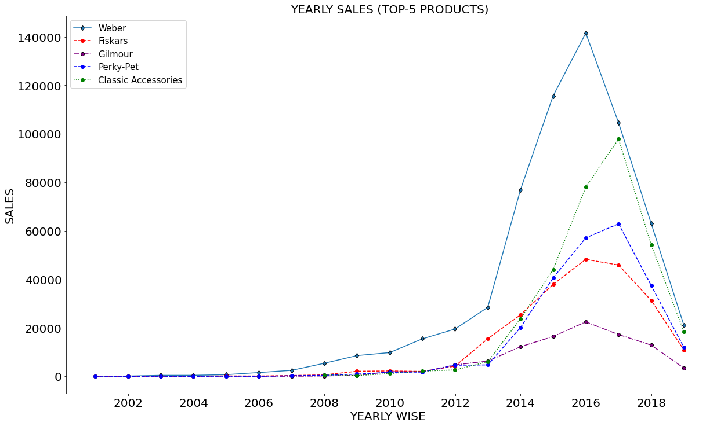
Sales
28

Slide 30
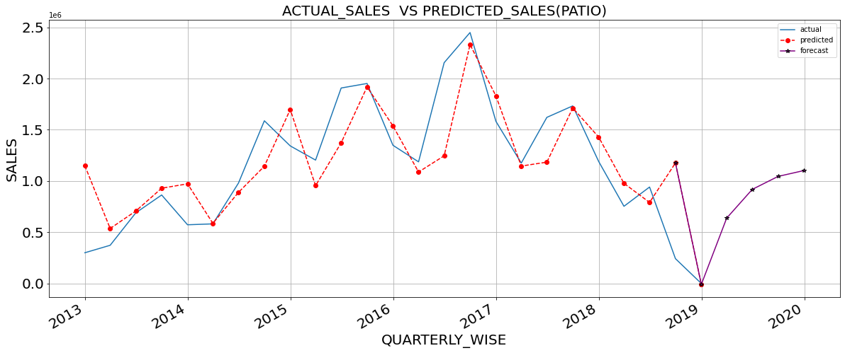
ActuAL, PREDICTED AND FORECASTED SALES OF PATIO LAWN AND GARDEN (2013-2020)
29

Slide 31
CONCLUSIONS
It is seen that among Tools & Home Improvement the most popular brands among customers are Dewalt, Stanley and Tekton. The most popular brands in Patio Lawn and Garden category were Weber, Fiskars and Gilmour.
From our sentiment analysis we see that brands like Weber and Intex had mixed results of positive and negative sentiments.
Brands like Weber and Classic Accessories were well-liked among customers and also generated high sales.
Analysing our product clustering based on price and rating, we observe a significant difference in the sales of poorly and fairly rated product clusters compared to best and well-rated clusters.
Weber and Perky-Pet brands had products across all the clusters and brands like Seedville, Scotts and Orbit mostly had products belonging to the poorly rated clusters
From our time series forecasting we observe that the future sales and demand for both categories will rise.
30

Slide 32
THANK YOU
Codebook link: click here

